Slide 1
Understanding the Issues: Textbook Affordability at USF
The USF Textbook Affordability Project, USF Libraries
January 18, 2018
Notes:
This PowerPoint provides an overview of textbook affordability at USF including:
the impact on students;
current legislation enacted to address the problem;
library services and resources designed to help faculty promote textbook affordability; and
what faculty and the institution can do to advance solutions.

Slide 2
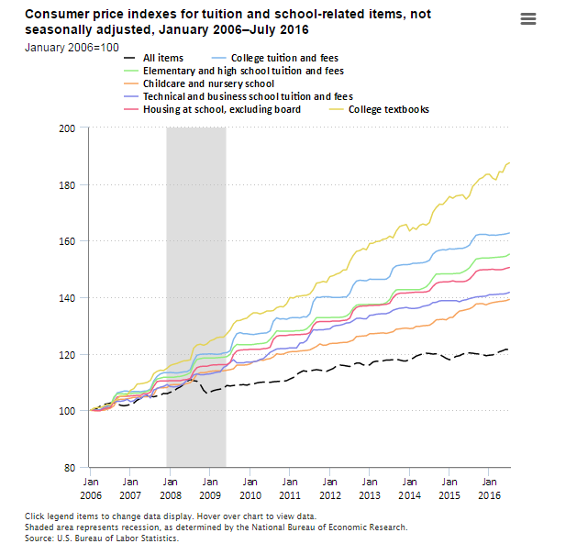
Rising Textbook Costs
Cost Increases in One Decade!
From 1977 to 2015, textbook prices have risen 3x the rate of inflation – 1041% increase
Textbooks +63%
Notes:
From January 2006 to July 2016, the Consumer Price Index for college tuition and fees increased 63 percent, compared with an increase of 21 percent for all items. Over that period, consumer prices for college textbooks increased 88 percent and housing at school (excluding board) increased 51 percent.
Source: U.S. Bureau of Labor Statistics

Slide 3
Why Focus on Textbook Costs?
Rules & Regulations
HB 7019
BOG Regulation 8.003
USF Regulation 3.029
IT IS THE RIGHT THING TO DO!
Costs & Barriers
Cost +1,041% 1977-2015
48-66% Do not buy texts
PBF Metric 3
Impacts Net Tuition
per Degree
Notes:
So, why are we focusing on textbook costs?
First, all universities within the State University System are subject to a compliance regimen that considers adoption dates, cost variation within courses with multiple sections, and duration of textbook usage.
In the Fall of 2018, textbook costs per student credit hour will be considered in the calculation of PBF Metric 3. The other variables include the cost of tuition, the number of credit hours to earn a BA, and the amount of financial aid available to students.
Finally, the escalating costs of textbooks and instructional materials introduce barriers to students who cannot afford to purchase them.
But in the end, we believe that reducing the cost of textbooks and instructional materials is simply the right thing to do!

Slide 4
Focus on USF
Average Cost of Textbooks/Credit Hour
National average = $40.83
USF average = $46.15
Notes:
The message to the President and Provost’s Textbook Affordability Task Force is ”It’s the Right Thing to Do.”
We have a high percentage of Pell Grant recipients at USF – 40.9%. 55% of all USF baccalaureate graduates received Pell Grants.
USF is justifiably recognized as a national model for eliminating the completion gap between Pell Grant recipients and those not receiving a Pell.
Source: Florida Board of Governors 2015-2016 Accountability Reports

Slide 5
Impact on Students
Source: 2016 Student Textbook and Course Materials Survey, Florida Virtual Campus
Notes:
A 2016 survey of students at Florida’s public higher education institutions (n=22,000; 3,000 USF respondents) identified how they are affected by the cost of textbooks.
The survey was also conducted in 2010 and 2012 with federal grant funding. Quoting the study — ”The results of the survey are sobering, as the findings suggest the high cost of textbooks and instructional materials are forcing many Florida higher education students to make decisions that compromise their academic success.”

Slide 6
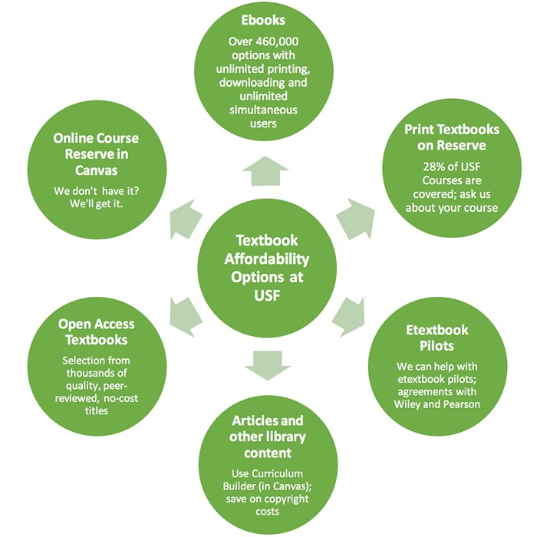
Resources from the USF Libraries to Help You Help Your Students
VISIT
Notes:
The USF Libraries have been working on textbook affordability initiatives since 2009. Visit the web site, tap.usf.edu for more information. Begin at the faculty link. Specific solutions:
Ebooks for the Classroom+ - a USF developed database to help faculty identify and select over 460,000 ebooks for course adoption with an unlimited number of users, and the ability to download and print at least a portion of the text.
Open Access Textbooks: the USF Libraries and USF Innovative Education have provided financial support for USF faculty authors of open access textbooks. We have compiled a list of the best sources of open access textbooks on the TAP web site and have a repository of open access textbooks created by USF authors. This repository is called Scholar Commons.
Print Textbooks on Course Reserve – The USF Libraries acquire print textbooks for use in courses with 75 students or more. Loan periods are generally short (3 hours to 7 days, depending on material type).Currently, 27% of USF courses are covered by a textbook from the popular Print Textbooks on Course Reserve collection.
Open Textbook Network (OTN) from the University of Minnesota – USF is a recent member along with over 379 colleges and universities focused on developing expertise on campus and encouraging faculty to adopt, adapt, and create OER while protecting academic freedom.
Curriculum Builder – it is a tool that supports faculty in the creation of reading lists within Canvas, with a click of a link.
The USF Libraries have worked with USF departments and faculty to implement etextbook pilots for specific courses. Etextbook pricing leads to significant reduction in costs and we are working to ensure long term access to the etextbook beyond graduation.

Slide 7
What Can USF do to Help?
Increase faculty awareness
Evaluate existing and create new practices to advance affordability
Develop a framework for assessing textbook impact; listen to students about their experience with textbooks
Develop incentives for faculty who drive textbook affordability
Move beyond compliance and metrics to own the textbook affordability issue
Notes:
Textbook affordability is an iterative process and no one solution works for all of our faculty. This is also a complicated issue that involves faculty, students, parents, administrators, faculty chairs, the Bookstore, the USF Libraries, the textbook publishers, etextbook platform providers, USF IT, the Provost, President, Board of Trustees, Board of Governors, legislators, and more.
We welcome your ideas on how we can advance textbook affordability at USF.

Slide 8
Contact Us
lib-tap@usf.edu
Alex Neff | Program Planner & Analyst
neffa@usf.edu | 813.974.4703
Rion Sabean | Web Content Administrator
rsabean@usf.edu | 813.974.6248
TAP.USF.EDU

