Slide 1
Understanding the Issues: Textbook Affordability at USF
The USF Textbook Affordability Project, USF Libraries
January 18, 2018
Notes:
The purpose of this PowerPoint is to present to the USF community the pressing issues surrounding textbook affordability at USF. We’ll look at:
the impact on students,
current legislation enacted to address the problem,
library services and resources designed to help faculty promote textbook affordability and,
what the University and faculty can do to advance this issue.

Slide 2
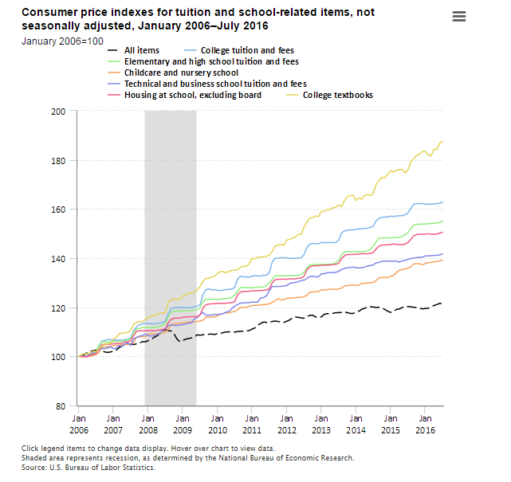
Rising textbook costs
Notes:
Note the yellow line indicating textbook costs. From January 2006 to July 2016, the Consumer Price Index for college tuition and fees increased 63 percent, compared with an increase of 21 percent for all items. Over that period, consumer prices for college textbooks increased 88 percent and housing at school (excluding board) increased 51 percent.
Source: U.S. Bureau of Labor Statistics

Slide 3
The Textbook Market
From 1977 to 2015, textbook prices have risen 3x the rate of inflation – 1041% increase
Source: Bureau of Labor Statistics (BLS)
Notes:
Over a longer time span, that 88% increase is now a 1041% increase.

Slide 4
Legislation and Regulations Specific to Textbook Affordability
Higher Education Opportunities Act (HEOA)
Florida Statute Section 1004.085(3)
Board of Governors Regulation No. 8.003
USF System Regulation 3.029
Notes:
How does textbook affordability legislation and regulations impact USF faculty and students?
Federal legislation: It is the intent of this legislation to encourage all of the involved parties, including faculty, students, administrators, institutions of higher education, bookstores, distributors, and publishers, to work together to identify ways to decrease the cost of college textbooks and supplemental materials for students while supporting the academic freedom of faculty members to select high quality course materials. The law took effect July 1, 2010. It was signed in to law by President Bush.
The Florida Statute, BOG Regulation, and USF System Regulation address the requirement to meet the 45 day deadline for textbook adoption. All Florida state universities are audited for compliance. The law also mandates that faculty document the intent to use all items ordered, including each individual item sold as part of a bundled package.

Slide 5
Performance-Based Funding Related to Textbook Affordability
Metric 3: Cost to Degree
Metric 4: Six Year Graduation Rate
Metric 5: Academic Progress Rate – Retention with G.P.A. above 2.0
Metric 7: University Access Rate, Percentage of Pell Grants
In 2018 – Textbooks will be a separate metric with a focus on affordability
Notes:
Within the State University System, all universities compete for state dollars based on performance metrics.
Currently, Metric 3 includes:
Textbook costs
Number of hours
Cost per credit hour
Amount of financial aid
In the Fall of 2018, textbook costs will become its own metric, a metric where the universities have a higher degree of influence on meeting the metric as opposed to number of hours required for a degree or the cost per credit hour. We will be competing for millions of dollars—if we can improve our textbook costs for our students.

Slide 6
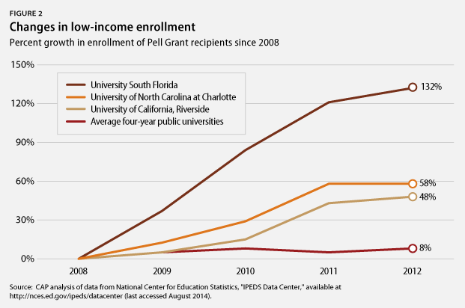
A Look at USF
Notes:
The current campaign message for the President and Provost’s initiative –The Textbook Affordability Task Force – is ”Do the Right Thing”. It is important to understand our student population in relation to other universities.
We do have a high percentage of Pell Grant recipients at USF.
40.9% of USF students are from limited income backgrounds and receive Pell Grants (29.7% at UF and 27.7% at FSU),
55% of all USF baccalaureate graduates have received Pell Grants (41% at UF and 38% at
FSU),
USF is recognized as a national model for eliminating the completion gap
(6-year graduate rate) between Pell Grant recipients and higher socioeconomic backgrounds.
Source: Florida Board of Governors 2015-2016 Accountability Reports

Slide 7
Cost of Textbooks at USF
Cost of textbooks, national average per credit hour: $41
USF average per credit hour: $46
Notes:
Yet, the cost of textbooks at USF is higher than the national average.
The textbook average was calculated within the following parameters:
Tampa Campus
Undergraduate
Required Textbooks
Max New Cost (excluded cheaper alternative formats)
Active Courses
For this calculation, we totaled the maximum new prices for all line items and divided it by (the number of course sections multiplied by the average credit hours per line item).
Max New Price Total / (Course Section Total * Average Credit Hour Per Line item)

Slide 8
Student Textbook and Course Materials Survey
66% of students cannot purchase textbooks due to cost
Source: 2016 Student Textbook and Course Materials Survey, Florida Virtual Campus
Notes:
In 2016, a survey of students at Florida’s public higher education institutions identified how students are affected by the cost of textbooks. There were 22,000 respondents, 17% of the total respondents’ major was Business. There were 3,000 USF respondents. The survey was also conducted in 2010 and 2012 with federal grant funding. Quoting the study—”The results of the survey are sobering, as the findings suggest the high cost of textbooks and instructional materials are forcing many Florida higher education students to make decisions that compromise their academic success.”

Slide 9
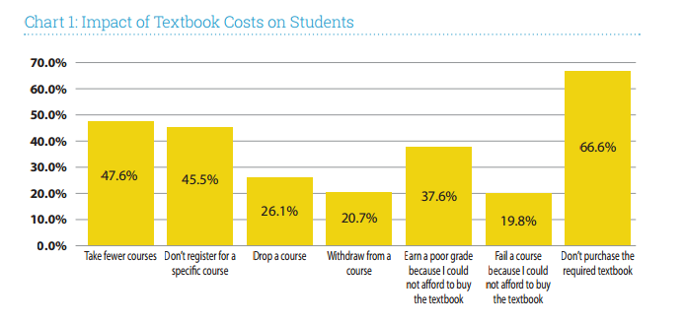
Textbook Costs: Impact on Florida Students in Higher Education
Source: 2016 Student Textbook and Course Materials Survey, Florida Virtual Campus
Notes:
The graph indicates the specific impacts on Florida students in higher education.

Slide 10
Resources from the USF Libraries to Help You Help Your Students
Textbook Affordability Project (TAP) website –
Ebooks for the Classroom+
Open access textbooks - scholarcommons.usf.edu/oa_textbooks - and tap.usf.edu/faculty/open-access-textbooks
Print Textbooks on Course Reserve
Notes:
The USF Libraries have been working on textbook affordability initiatives since 2009. Visit the web site, tap.usf.edu for more information. Begin at the faculty link. Specific solutions:
Ebooks for the Classroom+ - a USF developed database to help faculty identify and select over 460,000 ebooks for course adoption with an unlimited number of users, and the ability to download and print at least a portion of the text.
The database includes twelve major publishers including Wiley, Taylor & Francis (Routledge and CRC) and Oxford University Press and hundreds of additional publishers and imprints. There are 14,000 Springer ebook titles that have a print-on-demand option for students. Value of the entire ebook collection: $38,187,923.
Open Access Textbooks: the USF Libraries and USF Innovative Education have provided financial support for USF faculty authors of open access textbooks. We have compiled a list of the best sources of open access textbooks on the TAP web site and have a repository of open access textbooks created by USF authors. This repository is called Scholar Commons.
Print Textbooks on Course Reserve – The USF Libraries acquire print textbooks for use in courses with 75 students or more. In order to facilitate sharing of these high-use materials, loan periods are generally short (3 hours to 7 days, depending on material type).Currently, 27% of USF courses are covered by a textbook from the popular Print Textbooks on Course Reserve collection.

Slide 11
More Resources from the USF Libraries
Open Textbook Network
Launched Curriculum Builder in
Organized and supported etextbook pilots with Pearson, Wiley, and soon McGraw-Hill
Submitted USF Technology Fee proposal for Intellus
Notes:
Open Textbook Network (OTN) from the University of Minnesota– USF is a recent member along with over 379 colleges and universities focused on developing expertise on campus and encouraging faculty to adopt, adapt, and create OER while protecting academic freedom. In January of 2018, OTN trainers conducted workshops for USF faculty, department chairs, and deans to raise awareness of the value of open access content.
Curriculum Builder – it is a tool that supports faculty in the creation of reading lists within Canvas, with a click of a link.
The USF Libraries have worked with USF departments and faculty to implement etextbook pilots for specific courses. We are currently working with Pearson, McGraw-Hill, and Wiley for textbooks adopted by USF faculty for their courses. Students will access the etextbook in Canvas and be billed through their student account. Etextbook pricing leads to significant reduction in costs and we are working to ensure long term access to the etextbook beyond graduation.
The USF Libraries have recently submitted a USF Student Technology Fee
proposal to acquire Intellus, a tool that will be integrated in Canvas and is designed to help faculty adopt open access content and library content in lieu of expensive textbooks.

Slide 12
How Can Faculty Help?
DO …
DON’T …
Consider using quality, low-to-no cost alternatives (OER, ebooks, etc.)
Meet adoption compliance deadline (45 days before first day of classes)
Report “No Textbook Required” courses to the bookstore
Consider assessing textbook impact
Talk to your students about the use of the textbook in your courses
Make late changes to adoptions posted by deadline
Use ProCopy or other services – the USF Libraries can help reduce costs
Use “Adaptive Learning Platforms” unless critical to course quality
Notes:
All items are self-explanatory.
A note on ProCopy: USF students can save more $130,000 a semester by obtaining the same content distributed through ProCopy from the USF Libraries. At ProCopy, our students pay the copyright fees associated with the copying of the content. There are no such fees through the USF Libraries as we license this content on behalf of our faculty, staff, and students.

Slide 13
What Can USF do to Help?
Increase faculty understanding of the issues underlying textbook affordability
Market USF’s Textbook Affordability Project
Evaluate existing and create new practices that advance affordability
Develop a framework for assessing textbook impact; listen to students about their experience with textbooks
Develop incentives for faculty who drive textbook affordability
Move beyond compliance and metrics to own the textbook affordability issue
Notes:
Textbook affordability is an iterative process and no one solution works for some, let alone all of our faculty. This is also a complicated issue that involves faculty, students, parents, administrators, faculty chairs, the Bookstore, the USF Libraries, the textbook publishers, etextbook platform providers, USF IT, the Provost, President, Board of Trustees, Board of Governors, legislators, and more. We welcome your ideas on how we can advance textbook affordability at USF.

Slide 14
Contact Us
Laura Pascual | Electronic Resources Librarian
lcpascua@usf.edu| 813.974.2483
Micah Jenkins | Coordinator Library Operations
mqjenkins@usf.edu | 813.974.9449
Alex Neff | Program Planner & Analyst
neffa@usf.edu | 813.974.4703
Rion Sabean | Web Content Administrator
rsabean@usf.edu | 813.974.6248
TAP.USF.EDU

